Slide 1
Virtual Machine Encryption

Slide 2
Key Terms
Key Encryption Key (KEK)
Asymmetric key used to wrap other symmetric keys used by applications
Data Encryption Key (DEK)
Symmetric key used to encrypt data
Customer Managed Key (CMK)
Customer manages the access and lifecycle of the key
Platform Managed Key (PMK)
Cloud Service Provider (CSP) manages the access and lifecyle of the key
Account Encryption Key (AEK)
Symmetric key that is generated for each storage account and is used to create DEKs

Slide 3
Encryption System Components
Data
Encryption Engine
Key Management

Slide 4
Envelope Encryption

Slide 5
Azure Disk Encryption (ADE)
Key Facts
BitLocker feature of Windows and DM-Crypt in Linux
AES 256-bit DEK stored in Key Vault and optionally wrapped with KEK
VM uses system-assigned managed identity to access DEK in Key Vault
Benefits
End to end encryption
OS, Data, Temp Disks all can be encrypted
Limitations
Encryption engine is the OS so requires OS resources
Requires VM extension
No support for custom Linux VM images

Slide 6
Azure SSE for Managed Disks and Host-Based Encryption
Key Facts
KEK encrypts the AEK which is used to create DEK
AEK and DEK are AES 256-bit keys
Disk Encryption Set uses a system-assigned managed identity to decrypt AEK
Benefits
Encryption engine is outside of operating system
Not limited to a specific image on the VM
No VM extension require
Supports PMK and CMK
Limitations
OS and Data disks can use CMK but temporary uses PMK so if you need CMK across the board, you need to use ADE right now
No support for Ultra disks

Slide 7
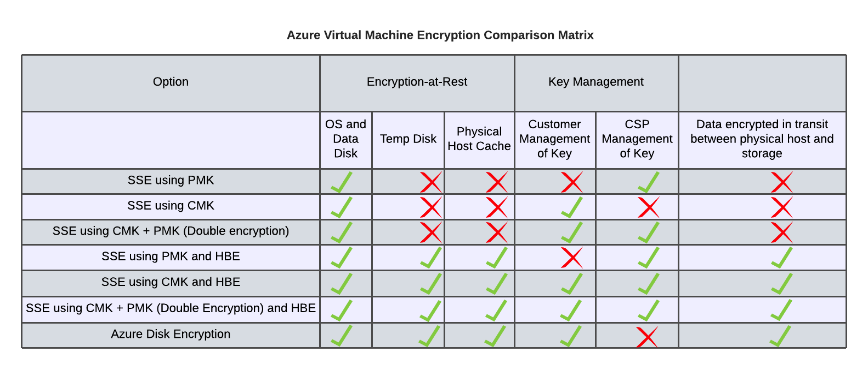

Slide 8
Resources
Managed Encryption Options in Azure - https://docs.microsoft.com/en-us/azure/virtual-machines/disk-encryption-overview
Linux SSE Managed Disks - https://docs.microsoft.com/en-us/azure/virtual-machines/linux/disk-encryption
Windows SSE Managed Disks - https://docs.microsoft.com/en-us/azure/virtual-machines/windows/disk-encryption
Encryption at Host (End to End Encryption) - https://docs.microsoft.com/en-us/azure/virtual-machines/linux/disk-encryption#encryption-at-host---end-to-end-encryption-for-your-vm-data
Azure Storage Encryption Process- https://docs.microsoft.com/en-in/azure/azure-monitor/platform/customer-managed-keys#encryption-keys-operation
Deep Dive Into Azure Disk Encryption - https://social.technet.microsoft.com/wiki/contents/articles/51631.azure-encrypt-azure-virtual-machine-disks-using-key-vault.aspx

